Slide 1
Synchronous Sequential Circuits
Lecture_12b_Design of counter using sequential circuit approach
Reference: Chapter 8, section 8.7, page 495, Stephen Brown, ZvonkoVranesic, “Fundamentals of Digital Logic with VerilogDesign”, Tata McGraw Hill Publishing Company Limited, Second Edition

Slide 2

Let us start with designing a counter!! (using FSM approach)
Specification for the counter is:
Same problem taken from Lecture_12a
Difference: circuit will be implemented using JK Flip-flop instead of D-FF

Slide 3
Design steps:(same for any designs using FSM approach)
1) state diagram
2) state table
3) state assignment table
4) find equations and
5) implement the circuit
Better to have (not necessary): Black box of circuit you are planning to design before step 1
??
w
Inputs to the circuit
Outputs of the circuit
clock

Slide 4
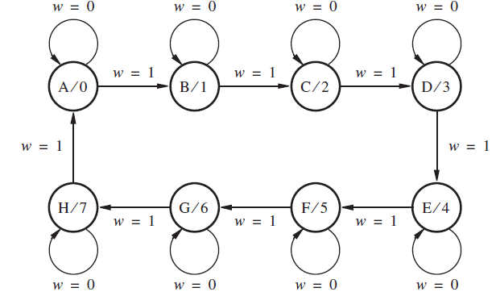
1) state diagram
Points to note:
1) decimal values of counter outputs can be written along with state labels in these cases

Slide 5
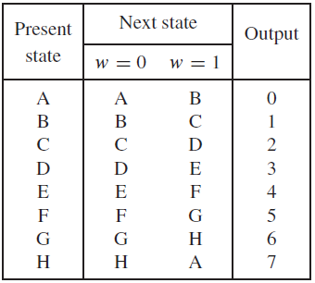
2) state table
Points to note:
1) decimal values of counter outputs can be written along with output column in these cases

Slide 6
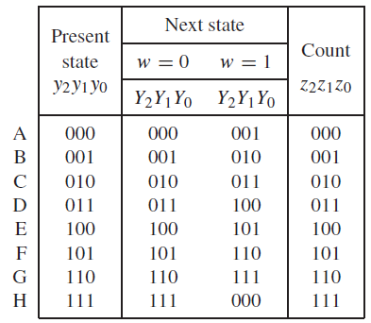
3) state assignment table
Points to note:
1) binary values of counter outputs are written.
compare present state column and Count column.
2) as far as possible, the binary of count (last column) is given to present state variables (first column), so here first column and last column are exactly same)

Slide 7
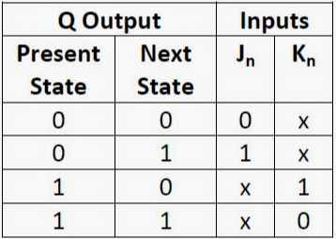


4) find equations
Points to note:
1) excitation table of the required Flip-flop is needed.

Slide 8
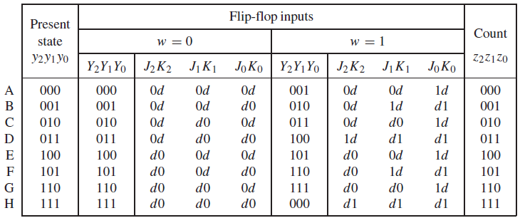
4) find equations...(cont'd)
Points to note:
1) the number of flip-flop inputs mentioned in the table.

Slide 9
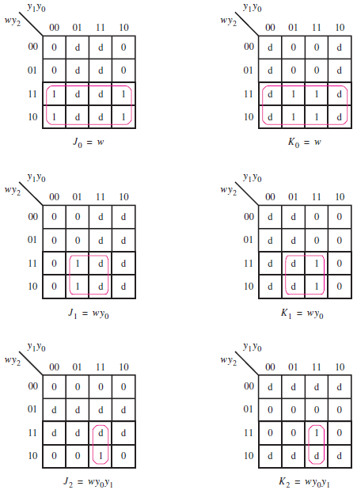


Slide 10
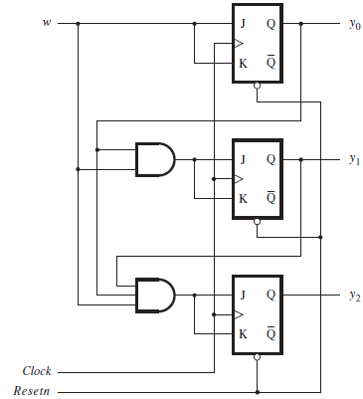
5) implement the circuit

Slide 11
Homework
1) For a counter circuit, the output sequence changes according to values of input signal 'm'. When 'm'=0 output remains same and when 'm'=1, counter increments output by 1. output sequences for the counter are: 0, 1, 2, 3, 4, 5, 0, 1, 2, …... Use FSM for designing the circuit and JK FFs for implementation.
2) For a counter circuit, the output sequence changes according to values of input signal 'w'. When 'w'=0 output remains same and when 'w'=1, counter increments output by 1. output sequences for the counter are: 6, 5, 4, 3, 2, 1, 6, 5, 4, …... Use FSM for designing the circuit and JK FFs for implementation.

